Slide 1



Low-Code AI:
Making AI Accessible to Everyone
Harish Chintakunta
MathWorks
hchintak@mathworks.com
LinkedIn Profile
Notes:
Hello and welcome to this session on low-code AI.
My name is Noah and I am a part of the education engineering team that supports ______.
In this session, I’d like to show you how AI can be accessible for everyone with interactive tools in MATLAB. You are welcome to follow along with the presentation, but I will also be providing the link to the materials used and a tutorial following this session.
If you have any questions following the presentation, the best way to contact me is by email!

Slide 2
Overview What will we see today?
Notes:
Here is a look at today’s agenda.
I will first cover the fundamentals of AI to get you all on the same page and then I’ll go straight into some exercises. The first exercise will be using unlabeled data which we then cluster into groups with similar characteristics. The second and third exercise will classify our data using machine learning and deep learning. And at the end, I’ll provide you some resources for further learning.
You can follow along with this presentation if you would like, but in the interest of time I will mainly be doing demonstrations.
I have a recording of this exact workshop as well as the link to all of the necessary materials and tutorials for this, so no worries if you miss something or forgot to bring a laptop.
NEXT

Slide 3
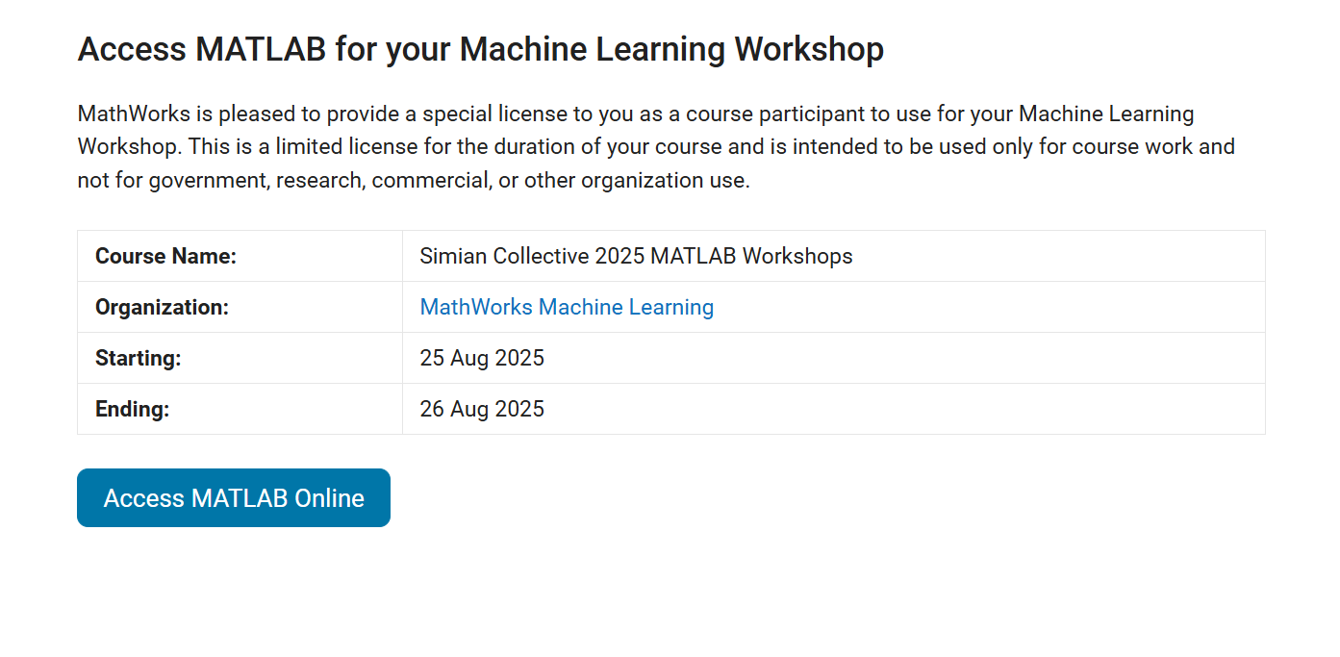
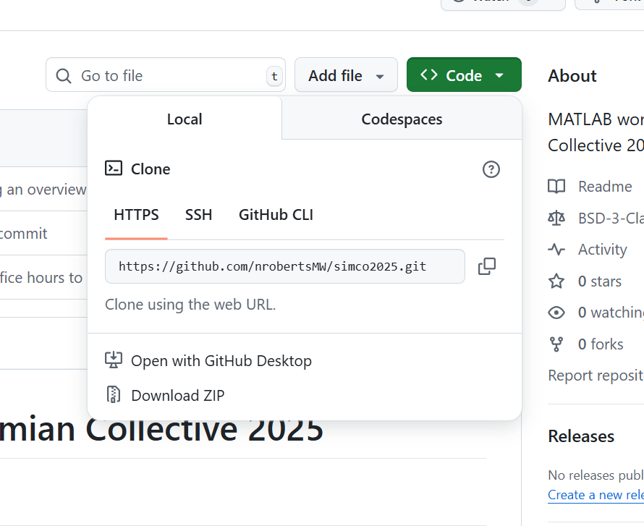
How to Access Materials
Set up a MathWorks account if you don’t have one
Go to https://www.mathworks.com/mwaccount/
Workshop license (if you don’t already have access to MATLAB)
https://www.mathworks.com/licensecenter/classroom/4969700/
Open the GitHub Repository
https://github.com/nrobertsMW/simco2025/
You can either clone the repo or download all the material
Notes:
Here is the information needed for you to follow along with the presentation.
At Delaware, you can use UDeploy to access MATLAB and there are on-campus computers that have it installed.
You can also access MATLAB Online for free for 20 hours each month, which is plenty of time to complete these activities.
You can open the workshop in MATLAB Online by clicking the “Open in MATLAB Online” button within the GitHub Repository

Slide 4
Learning Outcomes
Experience working with example problems
Design and train AI models with interactive tools
Automatically generate code for reuse
Notes:
At the end of this session, you will:
Have a fundamental knowledge of AI
Be able to design and train different ML and DL models without extensive knowledge of programming (although we will use a little bit of programming)
Learn how to automatically generate code from the interactive workflow. This will not only help you to reuse the models without manually going through all the steps but also to learn programming or advance your coding skills.

Slide 5



What is AI?
ARTIFICIAL INTELLIGENCE
Any technique that enables machines to mimic human intelligence
MACHINE LEARNING
Statistical methods that enable machines to “learn” tasks from data without explicitly programming
DEEP LEARNING
Neural networks with many layers that learn representations and tasks “directly” from data
1950s
1980s
2010s
Notes:
Artificial Intelligence is an “umbrella term” for any technique that enables machines to mimic human intelligence which includes amongst others reasoning, knowledge and learning.
<CLICK>
Machine Learning is a subset of AI focusing on the learning part. Here, the algorithm learns the task directly from the data based on statistical methods.
<CLICK>
Deep Learning is essentially a narrow subfield of machine learning which requires less understanding of the data as it it’s well known to learn representations and map relationships directly from raw data.
<CLICK>
Looking at the time span, you can see that AI is not a very new field, and this is the reason why some of the techniques are well matured.
NEXT

Slide 6




Traditional Programming
Programación Tradicional
Data
COMPUTER
Output
Program
Notes:
You could think of it this way – there are two different ways to get a computer to do what you want.
<CLICK>
The traditional approach, which I’m guessing most of us are familiar with, is to write a program that processes data to produce a desired output.
NEXT

Slide 7
Traditional Programming
Programación Tradicional
Data
COMPUTER
Output
Program
Notes:
With an approach called machine learning, this is flipped around – you feed data and the desired output, and the computer writes the program for you. ​
​
​
Now, it’s not quite accurate to call it a program….
NEXT

Slide 8
Machine Learning
Machine Learning
Data
COMPUTER
Model
Output
Notes:
... so they are called models instead.
Machine learning models are largely black boxes. They can generate the desired output, but they aren’t comprised of a sequence of operations like a traditional program or algorithm.
You can think of machine learning as a subset of AI – it’s the most common family of techniques applied today. In fact, people are often using the terms AI and machine learning almost interchangeably.

Slide 9
Types of Machine Learning
Type of Learning
Unsupervised Learning
Discover an internal representation from input data only
Machine Learning
Supervised Learning
Develop predictive model based on both input and output data
Notes:
Machine Learning is teaching an algorithm to do a certain task without explicitly defining it.
In general, Machine Learning can be branched into unsupervised learning and supervised learning.
In unsupervised learning, the model tries to find internal representations and relationships based only on input data.
In supervised learning, the model is developed and trained based on both, the input data and the output data.
<CLICK>

Slide 10
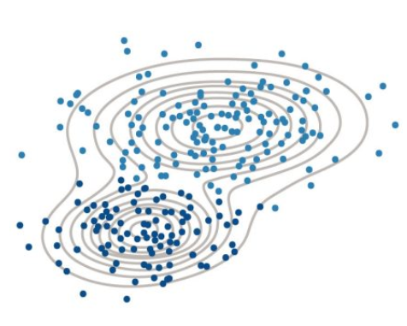
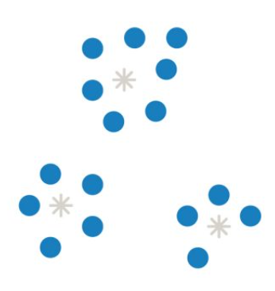
Types of Machine Learning
Type of Learning
Categories of Algorithms
Clustering:
Segmenting data into groups based on data similarity
Hard clustering models (e.g. k-means)
Soft clustering models (e.g. Gaussian mixture models)
To discover patterns, identify possible features, check for outliers
Unsupervised Learning
Clustering
Discover an internal representation from input data only
Machine Learning
Supervised Learning
Develop predictive model based on both input and output data
k-means
Gaussian mixture
More information on clustering can be found here.
Notes:
One type of unsupervised learning is clustering where the data is grouped based on some similarities/characteristics.
Depending on the underlying model, the data can belong to one class only, and this is the case of hard clustering models, or it can belong to multiple classes, and that’s called soft clustering methods.
Clustering can be used to discover patterns which can be useful for data labelling, but also to identify possible features, which can be useful for other machine learning algorithms.
Think about data coming from a smart watch someone may be wearing. This smart watch can detect if someone is sitting, standing, or moving.
It’s learning based on the data that it reads from the person moving, and it isn’t explicitly told what action is occurring at any moment. If sitting, then acceleration is probably zero. If the acceleration is constant, then perhaps the person is walking.
NEXT

Slide 11
Types of Machine Learning
Type of Learning
Categories of Algorithms
Regression:
Predicted variable (response) is continuous (number)
Unsupervised Learning
Clustering
Discover an internal representation from input data only
Machine Learning
Regression
Supervised Learning
Develop predictive model based on both input and output data
Notes:
In supervised learning, as I said, we are developing predictive models.
This is developed from input and output data. So, using our smart watch example, in supervised learning, the activity being performed for specific sensor measurements is known.
If the predicted response is continuous in nature, meaning it is a number, then it is a regression problem. For instance, if you are trying to predict future electricity demand from a power grid.
NEXT

Slide 12

Types of Machine Learning
Type of Learning
Categories of Algorithms
Classification: Predicted variable (response) is discrete (class)
Data:
Unsupervised Learning
Clustering
Discover an internal representation from input data only
Machine Learning
Inputs | 3-axial Accelerometer 3-axial Gyroscope
Outputs
Regression
Supervised Learning
Classification
Develop predictive model based on both input and output data
Notes:
In a classification problem, the output variable is discrete, so it’s a category.
Lets say you want to classify images.
Ever done one of those CAPTCHAs that asks you to select all of the boxes with traffic lights? That was you classifying those images!
NEXT

Slide 13
Types of Machine Learning
Type of Learning
Categories of Algorithms
Deep Learning
Unsupervised Learning
Clustering
K-Means,
K-Medoids
Hierarchical
Gaussian Mixture
Neural Networks
…
Machine Learning
Regression
Support Vector Machines
Discriminant Analysis
Nearest Neighbor
…
Neural Networks
Supervised Learning
Classification
Support Vector Machines
Discriminant Analysis
Nearest Neighbor
…
Neural Networks
Notes:
I will not go into details about all the models which are used for the individual techniques but here you can see some commonly used ones.
You can also see that Neural Networks can be applied for Regression, Classification and Clustering. However, it’s not a single model type, it’s rather a subset of numerous different models with different requirements.
NEXT

Slide 14
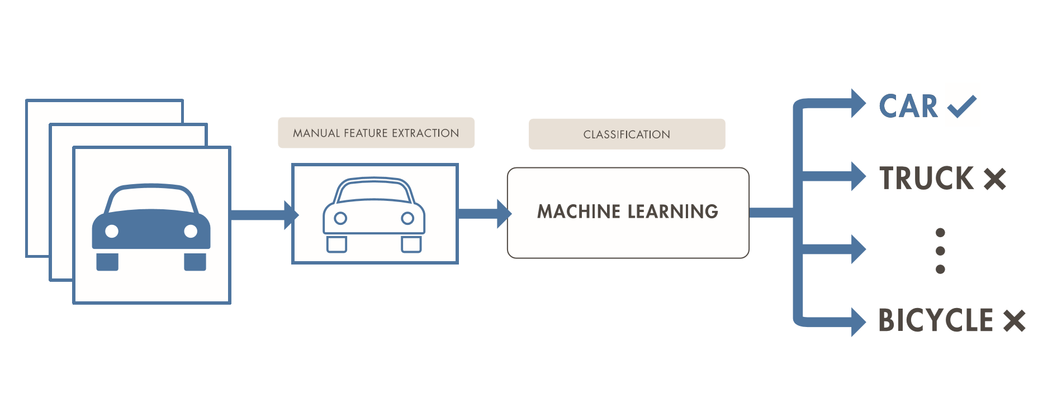
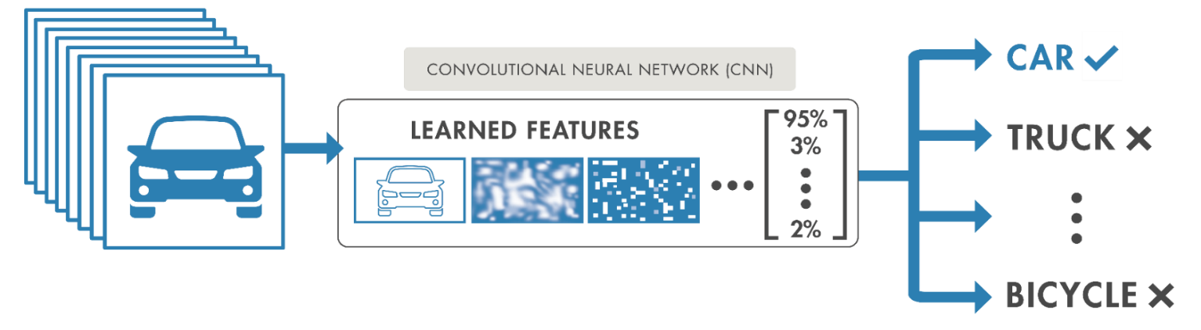
Machine Learning vs Deep Learning
Decide on nature of the features …
…and the type of model.
Machine Learning
Domain knowledge required!!!
Decide on the architecture.
Deep Learning
A LOT of data is required!!!
Notes:
So, what is the difference between Machine Learning and Deep Learning?
Machine learning models require features and this on the other hand requires domain knowledge.
Let’s say I have images of vehicles that I need to classify into Car, Truck, and Bicycle.
I as the programmer will manually point out to my model to look at a specific feature to determine the class.
For example, the number of tires!
Deep learning was developed to overcome this limitations and features are learned by the network. For this reason, deep learning models require a lot of data to learn these features.
Deep learning does not require the same manual intervention to classify things, but it learns these features and decides on its own.
NEXT

Slide 15
Let’s jump into some exercises

Slide 16
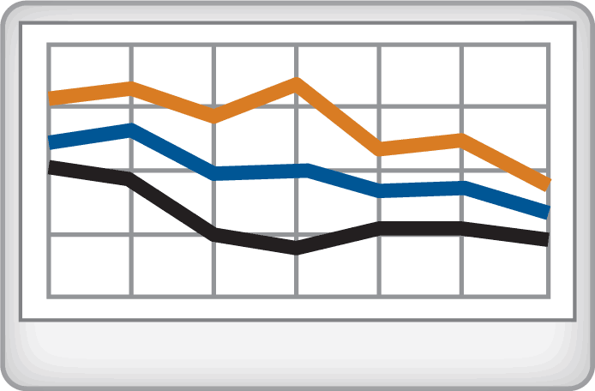
Running example: Human Activity Classification
Task: Classify activity data acquired from the sensors in a mobile phone
Algorithm
Case 1: no labels are available clustering
Case 2+3: labels are available classification
machine learning
deep learning
Dataset courtesy of:
Davide Anguita, Alessandro Ghio, Luca Oneto, Xavier Parra and Jorge L. Reyes-Ortiz. Human Activity Recognition on Smartphones using a Multiclass Hardware-Friendly Support Vector Machine. International Workshop of Ambient Assisted Living (IWAAL 2012). Vitoria-Gasteiz, Spain. Dec 2012
http://archive.ics.uci.edu/ml/datasets/Human+Activity+Recognition+Using+Smartphones
Notes:
In today’s demos, we will use the human activity classification example as I think it is easy to understand regardless of your background.
We will be using data which was acquired from sensors in a smartphone.
In the first case, we will assume that we do not have the labels and hence, we do not know what the measurements represent. So, we will apply a clustering method to find groups of data with similar characteristics.
In the second case, we will then train a machine learning model to classify the measurements into activities.
So, let’s jump into it!
GO TO MATLAB

Slide 17



Recap
Clustering can be used to label raw data
Classification Learner lets you try out different models
Deep Network Designer lets you design networks interactively
Notes:
Now, let’s have a recap and see what you should have learned today.
First, we saw that clustering can be used for labelling the data. There are of course many other, maybe easier ways, to label data but clustering is definitely one of them.
You could see (and hopefully try out) how you can train and evaluate different machine learning models in the classification learner.
And you learned how to design a neural network from scratch using deep network designer.
NEXT

Slide 18

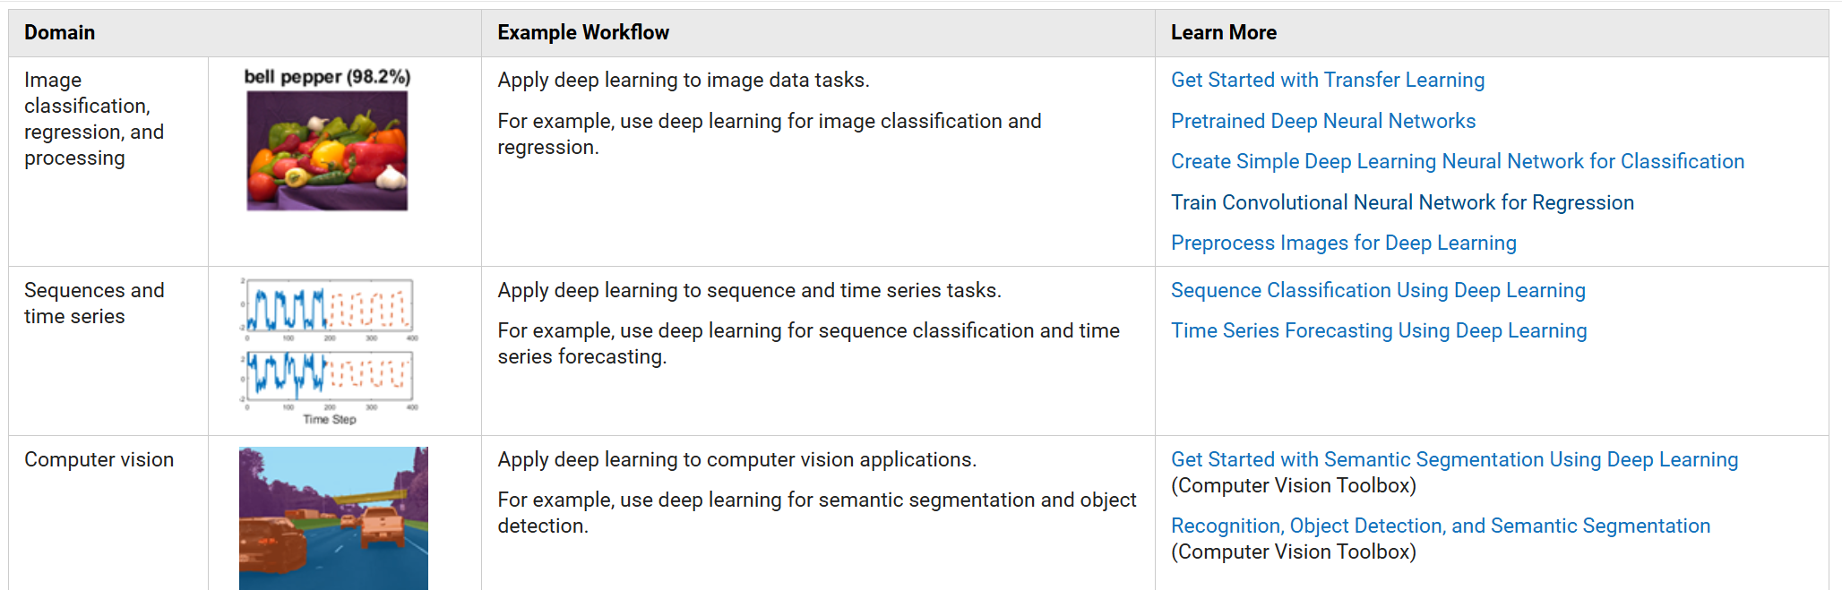
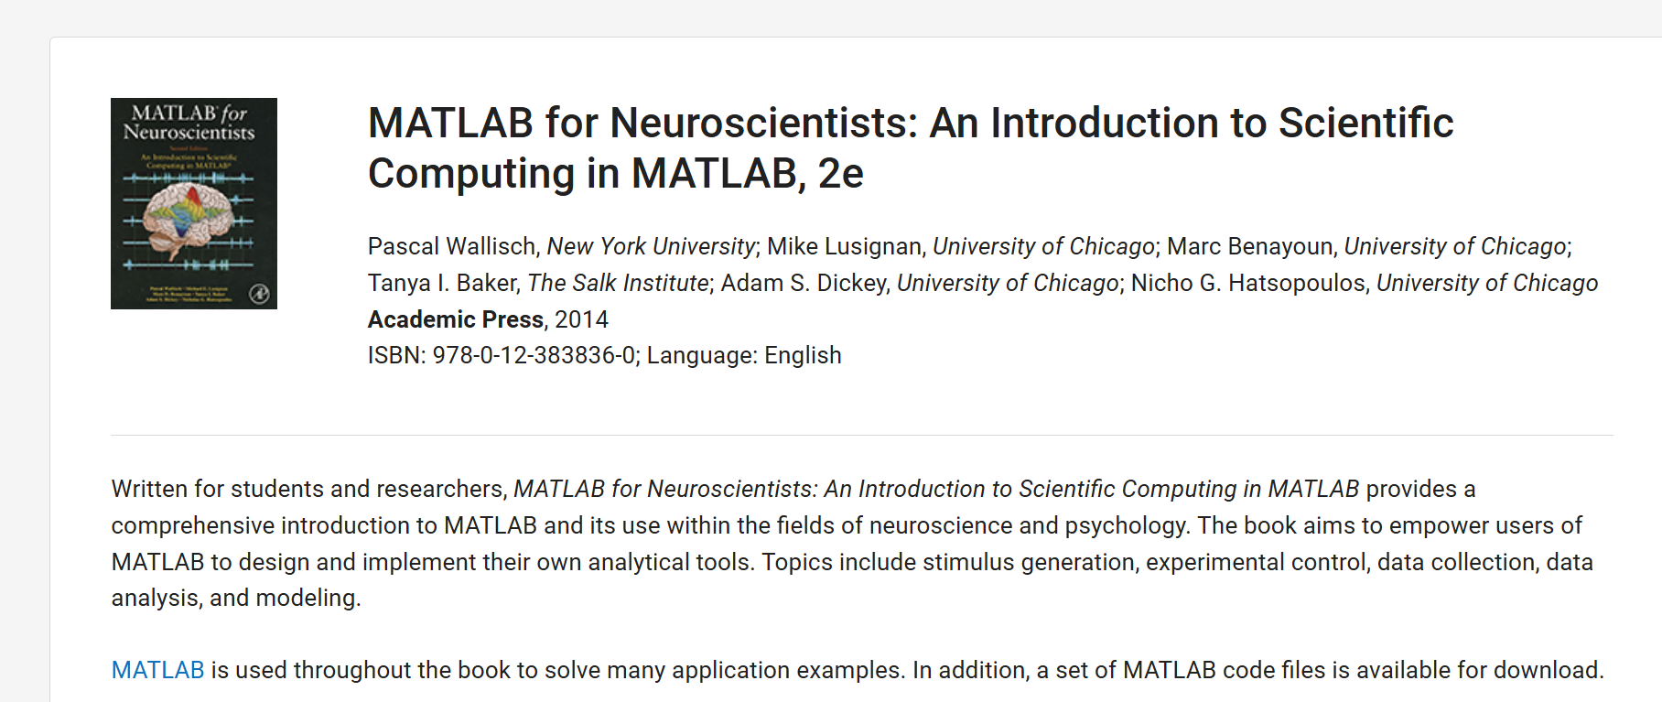
Relevant textbooks and doc examples

Slide 19
Key takeaways
Ease-of-use through interactive tools
AI accessible to everyone
Interactive tools can enhance programming skills
Notes:
To summarise the key takeaways,
MATLAB has a large set of interactive tools which are easy to use.
The low-code tools make AI accessible to everyone without a lot of programming.
In fact, these low-code tools allow you to learn writing code and advance your programming skills.

Slide 20

Ideas for further practice
What could you do now?
Try out different clustering techniques
Try to improve the accuracy of given models
Try to collect your own data and do the exercise with own data
…
Click on me
Notes:
Here are some ideas, you could do next:

Slide 21
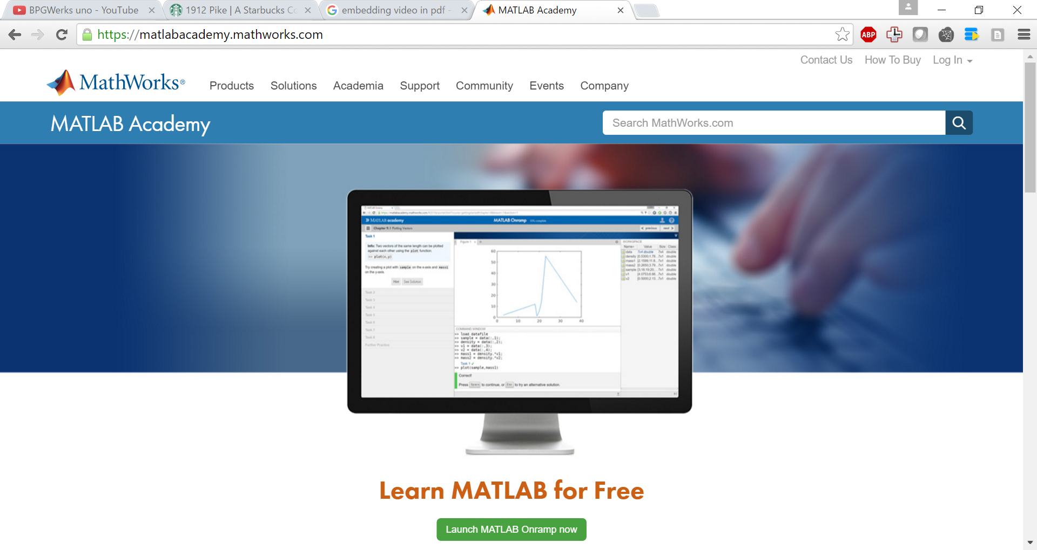
Supporting Your Success Self-Paced Online Trainings
FOCUSED COURSES
FOUNDATIONAL COURSES (17-21 hours)
MATLAB Fundamentals
Simulink Fundamentals
MATLAB Programming Techniques
MATLAB for Data Processing and Viz
Machine Learning with MATLAB
Deep Learning with MATLAB
COMPUTATIONAL MATH COURSES (2-3 hours)
Introduction to Linear Algebra
Introduction to Symbolic Math
Solving Ordinary Differential Equations
Introduction to Statistical Methods
Solving Non-Linear Equations
Introduction to Symbolic Math with MATLAB
OVERVIEW COURSES (2-3 hours)
MATLAB Onramp
Simulink Onramp
Stateflow Onramp
Simscape Onramp
Machine Learning Onramp
Deep Learning Onramp
Reinforcement Learning Onramp
Control Design with Simulink Onramp
Power Electronics Onramp
Signal Processing Onramp
Image Processing Onramp
Wireless Communications Onramp
Circuit Simulation Onramp
Optimization Onramp
matlabacademy.mathworks.com
Notes:
We have many self-paced online training courses that you can explore.
The overview courses are shorter and open to all.
All you need is an internet connection and a MathWorks account, which is free to create.

Slide 22
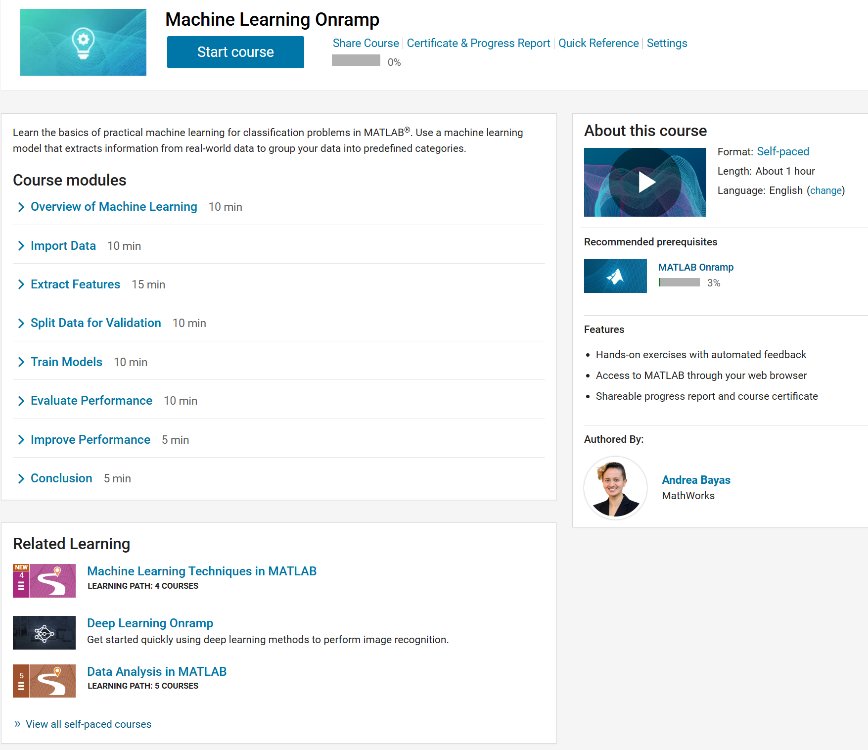
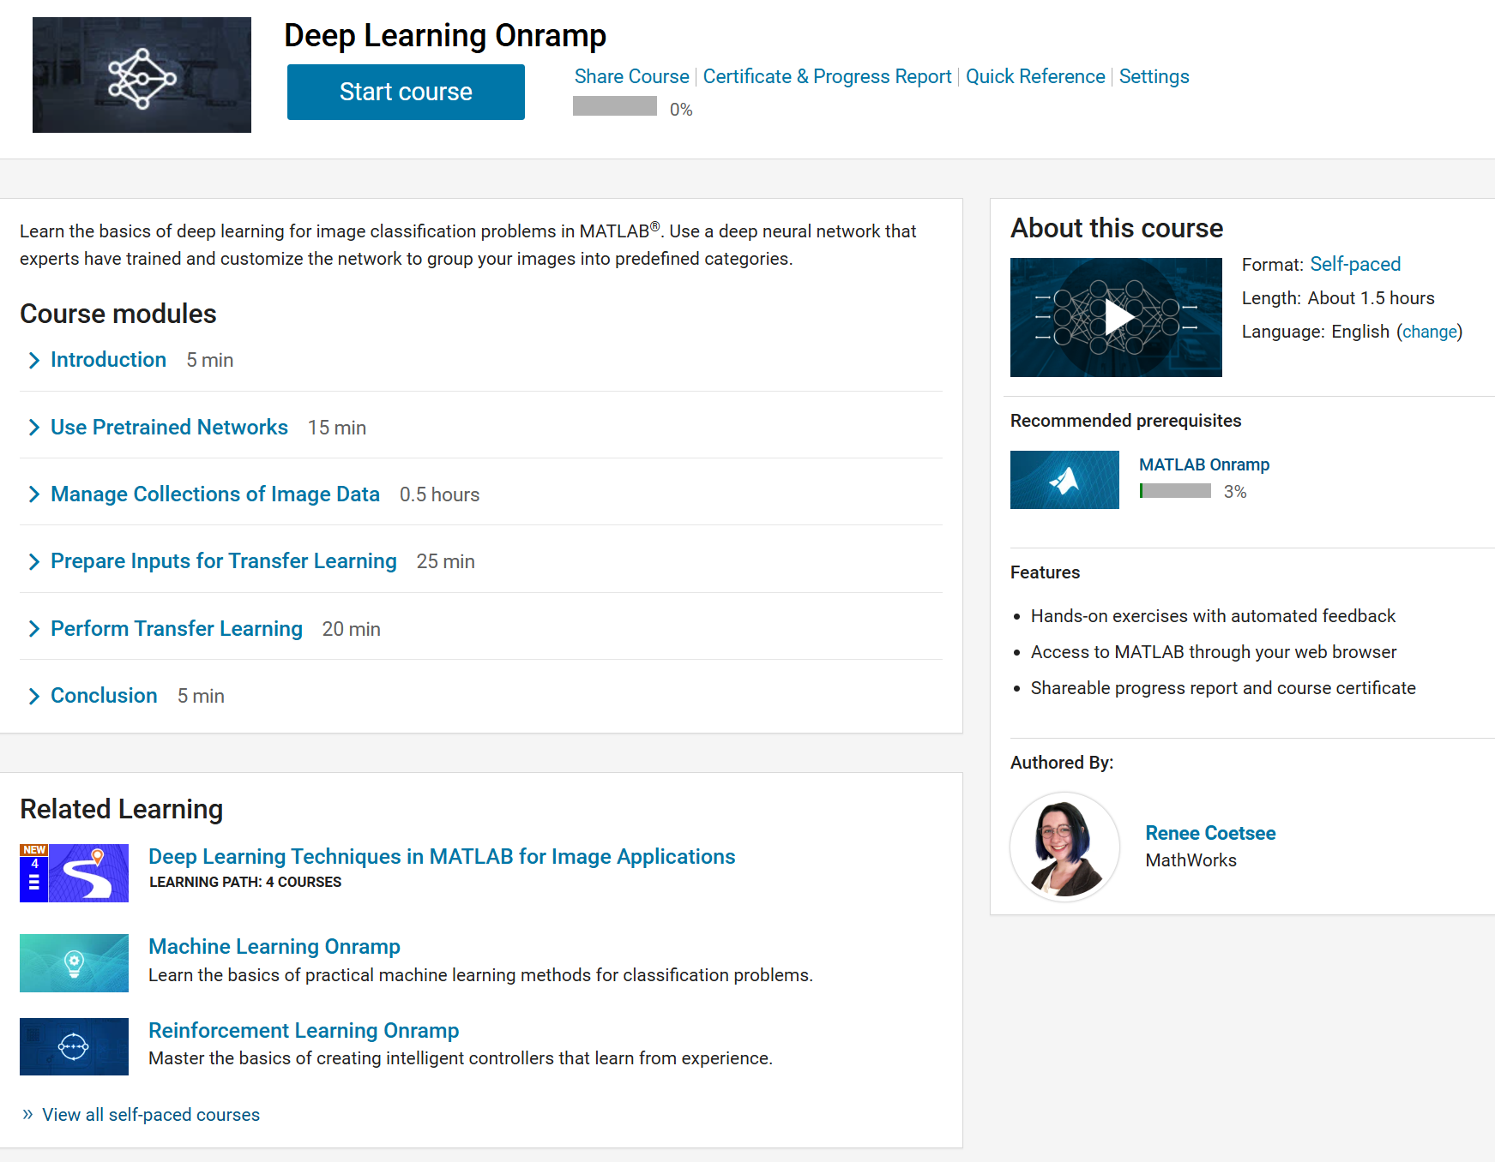
Self-Paced Courses FREE “getting started” content – available for everyone
https://matlabacademy.mathworks.com/
matlabacademy.mathworks.com
Notes:
We have specific onramps for topics covered today, like Machine Learning and Deep Learning.
These also display related learning so you know what prerequisites may exist (such as the MATLAB Onramp first)

Slide 23

Continue the conversation!
MathWorks Education Application Engineers
Harish Chintakunta
hchintak@mahtworks.com
We consult with faculty and researchers to support them with their STEM initiatives, including integrating computational or systems thinking into their curriculum and research
Office hours with my colleague Noah
Meet with Noah on 08/26
(link also in GitHub Repository!)
Link

Slide 24
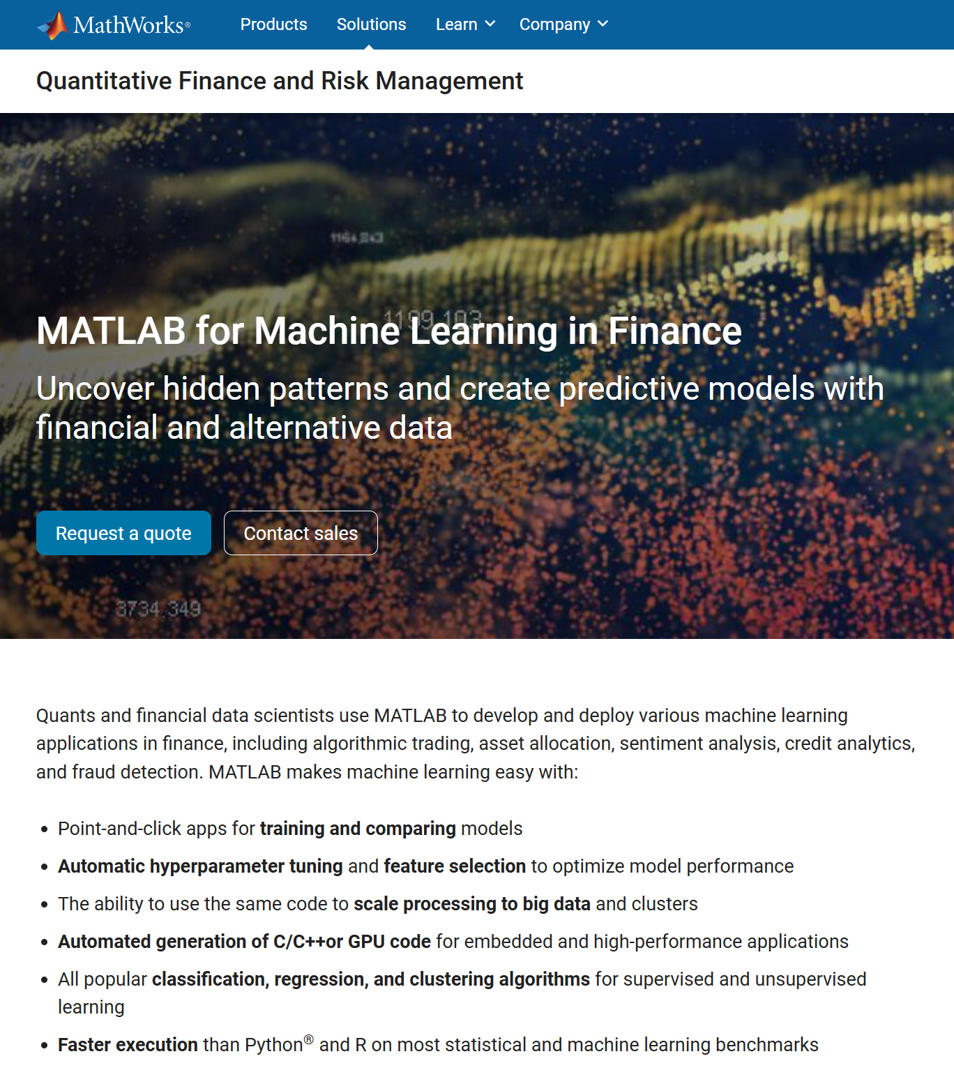
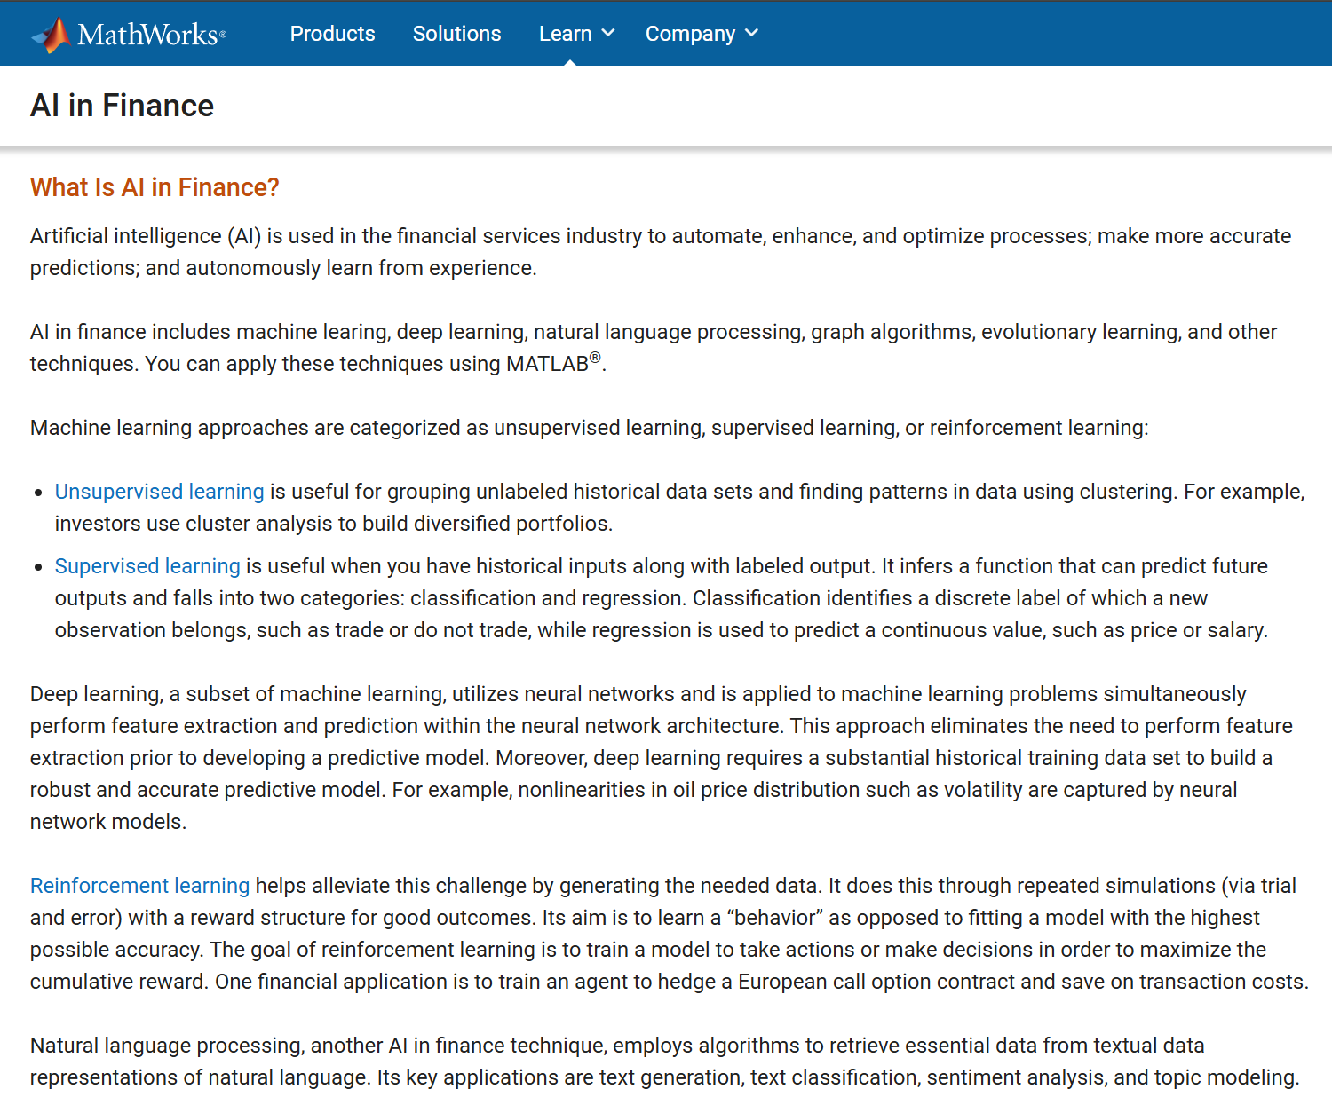
Supporting Your Success AI/ML in Finance Resources
https://www.mathworks.com/discovery/ai-in-finance.html

Slide 25
Thank you!
© 2022 The MathWorks, Inc. MATLAB and Simulink are registered trademarks of The MathWorks, Inc. See mathworks.com/trademarks for a list of additional trademarks. Other product or brand names may be trademarks or registered trademarks of their respective holders.
Notes:
Thank you for your time, and I hope you all enjoy the Hackathon!

Slide 26

Engineering Development Group (EDG)
Degrees Hired (BS, MS, PhD)
Computer Science
Electrical Engineering
Mechanical Engineering
Computer Engineering
Other Eng Disciplines
Notes:
​

Slide 27
EDG Structure & Timeline
Training
Customer Interaction
Project Work
Build Product Knowledge
Cohort Style: Built in Network
Learn about customer workflows
Help customers with MATLAB and Simulink
Develop your skills
Find ideal team for you
3 Months
Variable time span
Typical = 12-14 months
Notes:
Training
There are 3 main components to the EDG
All our new hires go through a cohort style training program – that is great because you get a built in network to start your career with
This training program is ideal for new hires to build product knowledge…it means that no one has to know MATLAB or Simulink before you join
Technical Support
All EDGers get the chance to work closely with our customers on complex technical issues
They have the chance to learn customer workflows
Help customers with MATLAB and Simulink
Not everyone gets access to Tech Support; some of our customers include large engineering organizations
Project Work
The project work is completely driven by the EDGer
The EDGer has the chance to craft their own journey
They have the chance to develop their skills and find the ideal team for them
The typical timeline is shown here. 3 months of cohort style training. Most EDGers will transfer to there new teams in about 12-14 months.

Slide 28
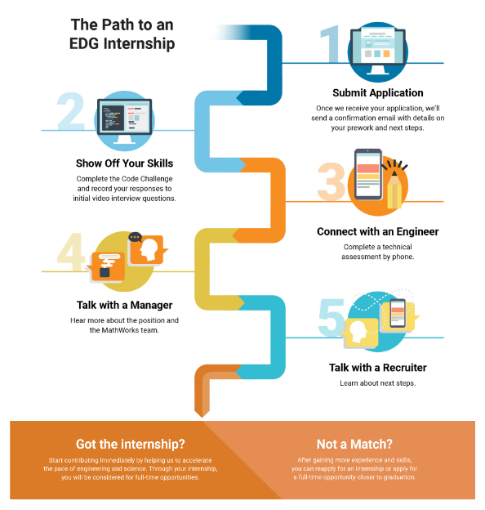
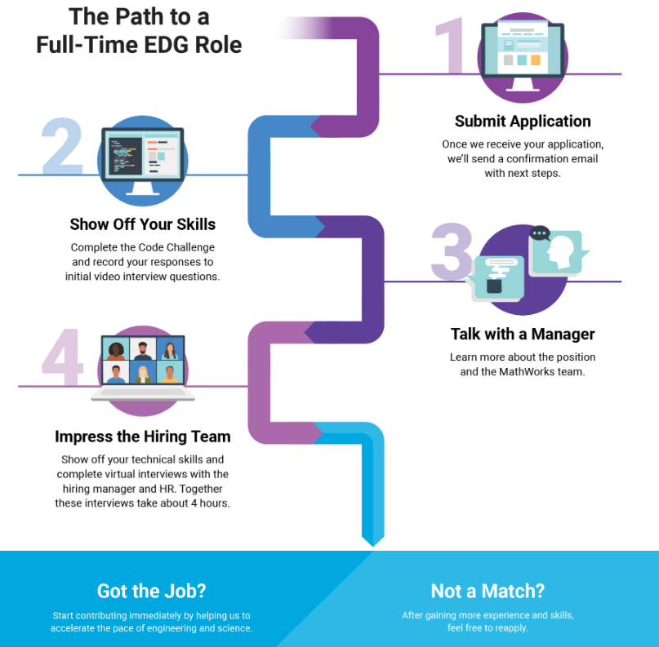
The Hiring Process
Notes:
MathWorks Is Hiring - MATLAB & Simulink

Slide 29
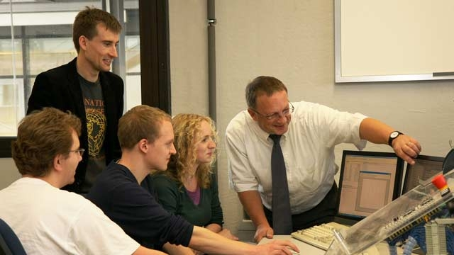
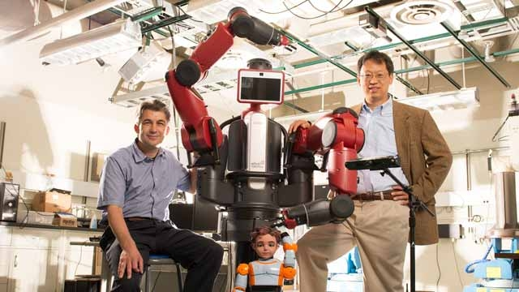


MathWorks Education Application Engineers nroberts@mathworks.com consult with faculty and researchers to support them with their STEM initiatives,
including integrating computational or systems thinking into their curriculum and research
Notes:
If you have any questions, you should reach out to your customer success team at MathWorks by emailing education@mathworks.com.
Specifically, we work with faculty and researchers to support curriculum updates, contribute to Industry Advisory Boards, and advise on latest technology for multidisciplinary research and commercialization efforts. <click>

